Slide 1
Work Book
File created on: 31/03/2023 15:29:55

Slide 2
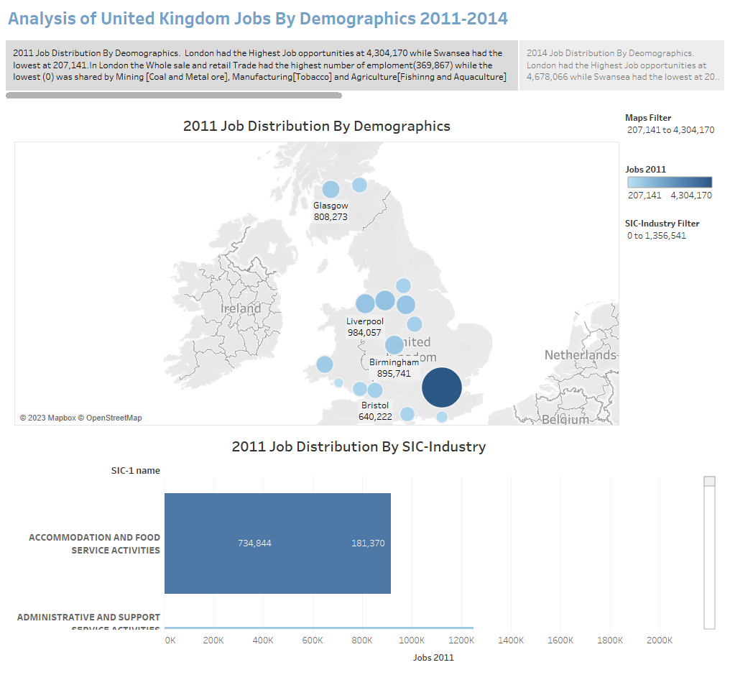

Slide 3
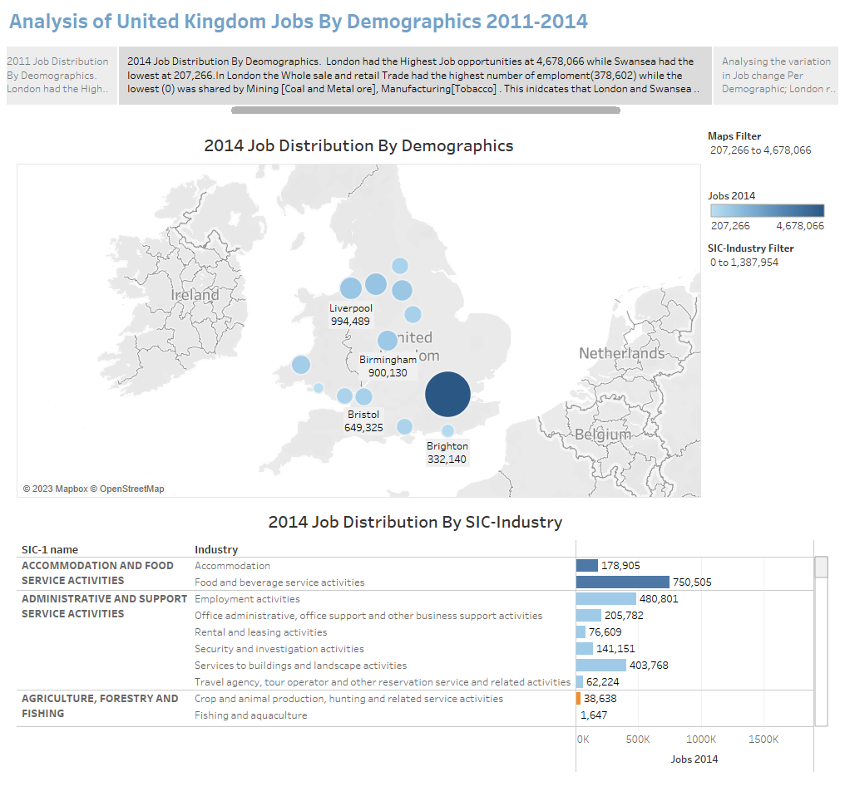

Slide 4
